Slide 1
Outer Planets
By: Mrs. Cosnowski

Slide 2
Outer Planets
There are 4 outer planets:
Jupiter
Saturn
Uranus
Neptune
These are the largest planets in our Solar System and are made primarily of gases. All these planets are called gas giants.
Remember the sentence for remembering the order of the planets:
My Very Energetic Mother Just Served Us Nachos

Slide 3
Jupiter
•Jupiter is the largest planet in our Solar System. 1,000 Earths could fit inside Jupiter.
•This massive planet rotates 2-3 times as fast as Earth completing one rotation every 9-10 hours.
•The big red spot on Jupiter is a storm that has lasted for more than 300 years. It’s also known as “The Eye of Jupiter.”
•Under Jupiter’s thick atmosphere which is composed of hydrogen (H₂) and helium (He), is an ocean of liquid hydrogen and water.
•Jupiter has three very faint rings. Their names are Gossamer, Main and Halo.
•There are currently 62 moons that orbit Jupiter.
If you weighed 70 pounds on Earth, you’d weigh 185 pounds on Jupiter because of Jupiter’s size.

Slide 4
Saturn
•Saturn is very similar to Jupiter, although it’s much smaller.
•The atmosphere on Saturn is composed of methane (CH₄) , hydrogen (H₂) and helium (He). It eventually becomes thicker until it becomes an ocean of liquid chemicals.
•Although Saturn is very large, it actually has a lot less gravity than you’d expect because the gases that make up the planet are very light. The planet is the lightest planet that we know of.
•Saturn is known for its beautiful rings. There are 7 sections of rings.
•The rings around Saturn are made of ice, rock and dust.
This is a picture of Titan, one of Saturn’s 63 moons.

Slide 5
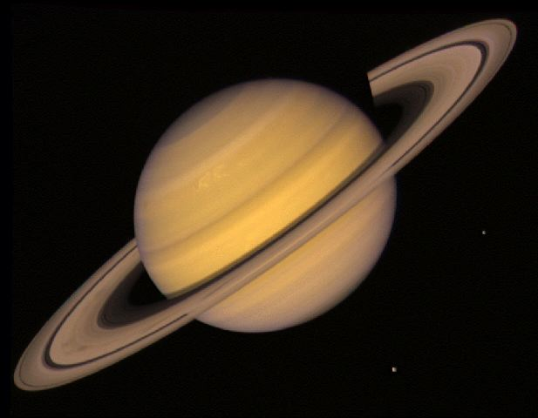
If you weighed 70 lbs. on Earth, you’d only weigh 74 lbs. on Saturn.

Slide 6
Uranus
•One interesting fact about Uranus is that it spins or rotates on its side.
•The atmosphere is similar to Saturn being made primarily of methane (CH₄), hydrogen (H₂) and helium (He) gases.
•This planet is so cold that it is often called the “ice giant.”
•We believe that it is made up of ice and rock with a rocky core.
•Scientists also believe there might be a huge ocean covering the surface of Uranus that is very HOT!! Maybe even 5,000⁰ F.
•There are several rings that orbit Uranus.
Uranus has my favorite moon. There are 27 moons all together, but my favorite is Ariel, Uranus’ brightest.

Slide 7
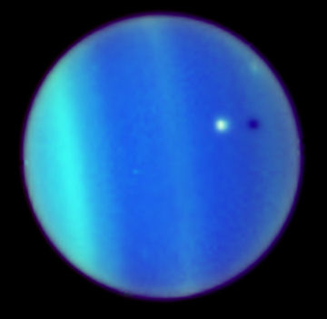
It takes 30,684 days for Uranus to revolve one time around the Sun.

Slide 8
Neptune
•Like Saturn and Uranus, Neptune’s atmosphere is composed of 3 main gases: hydrogen (H₂), helium (He) and methane (CH₄).
•Neptune has the strongest winds of any planet in the Solar System. Scientists believe they reach speeds up to 1,200 mph.
•Like all the other gas giants, Neptune also has a set of rings. There are 6 of them all together.
•Neptune has 13 known moons. The first moon to be discovered was Triton.
The large dark spot that you see is thought to be a large storm. It has since disappeared.

Slide 9
Pluto – The Most Famous Dwarf Planet
•Pluto lost the privilege of being called a planet in 2006.
•Pluto is 2/3 smaller than our own moon.
•Pluto has 5 moons. One of those moons is Charon which is ½ the size of Pluto. They believe the surface of Charon is covered in water ice.
•An 11 year old child named Pluto when it was discovered in 1930 after the Roman god of the underworld.
•Currently there are 5 dwarf planets in our Solar System. From largest to smallest they are: Eris, Pluto, Makemake, Haumea, Ceres
The surface of Pluto is thought to be mainly nitrogen (N₂) and methane (CH₄) ice.

Slide 10
NASA Probe Nears Pluto
New Horizons space probe is due to fly by Pluto on July 14, 2015. It is traveling at a rate of 36, 373 mph and will have traveled nearly 3 billion miles. It will capture our first actual pictures of Pluto before in continues on its mission to the Kuiper belt. The mission will officially end in 2026.

Slide 11
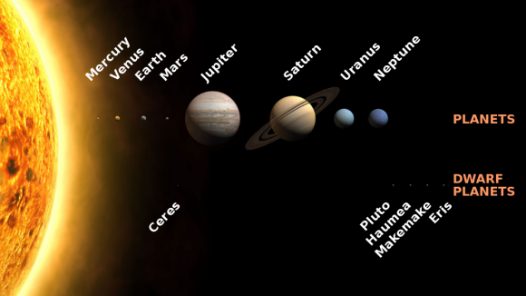
Reminders
There are 8 planets that all orbit the Sun.
Mercury, Venus, Earth and Mars are inner, terrestrial planets.
Jupiter, Saturn, Uranus, Neptune are outer, gas giants.
Pluto is no longer considered a planet, but is now a dwarf planet, and there are 4 other dwarf planets currently in our Solar System.

