Slide 1
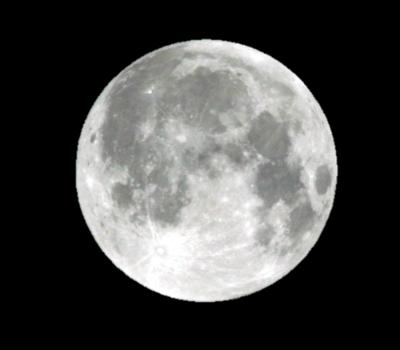
The Moon
By: Mrs. Cosnowski

Slide 2
A Native American Myth
“Coyote's Sad Song to the Moon”
From "Race With Buffalo and Other Native American Stories for Young Readers”
A story of the People of the Eight Northern Pueblos along the Rio Grand in New Mexico.

Slide 3
Long ago, when the world was young, the sky was very dark at night. The Creator Spirit that had made the world had made the sun to ride across the sky by day, but the night sky was empty. The Creator Spirit heard the prayers of the People and the animals who wanted to be able to see at night. He called on Coyote to come to him and serve him.

Slide 4
Coyote came and waited respectfully, looking down as the Creator Spirit gave him a deerskin pouch tied with a piece of sinew. The Creator Spirit told Coyote to walk a certain path and to open the bag when he came to the highest point on the trail. Coyote was not to open the bag any sooner than the highest point. The Creator Spirit told Coyote that the trail would be long, and he would go many days and nights without rest. He told Coyote to be strong.

Slide 5
Coyote took the pouch and went on the path he had been given.
Coyote was not highly regarded by the people and other animals, and he was proud to have been chosen to take the pouch to the highest point on the trail. At first he walked proudly, the pouch hanging from his mouth, along the path he had been given. As the day wore into night, and the night became day again, Coyote walked less proudly. He grew tired and hungry, and cared less about the great honor that had been given to him. As another night came and went, the spit from Coyote’s mouth soaked into the dried deer sinew, and it began to soften, and tasted like meat.

Slide 6
Before he knew what he was doing, Coyote was chewing on the sinew, just as a hunter on a long hunt will chew on dried meat. Soon the sinew was chewed in two, and the pouch fell out of Coyote’s mouth. Coyote was only halfway up the great mountain when the pouch fell. The pouch hit the ground and came open. Out of the pouch flew thousands of pieces of shiny mica; they flew like the butterflies up into the sky and settled against the blanket of night to become the stars. Out of the pouch rolled a ball of mica, and it rolled up the trail and into the sky to become the moon.

Slide 7
But Coyote was not at the highest point of the trail when the pouch came open, and the moon did not climb into the sky on its proper path. Instead of riding only across the night sky, the moon sometimes comes up at night, and sometimes comes up by day. And it turns this way and that, like a hunter who is lost, looking for the proper path to follow.

Slide 8
Because he did not live up to the trust the Creator Spirit had placed in him, Coyote hung his head in shame. Then he looked up to the moon and sang sadly his apology to the moon for his lack of courage.
To this day, Coyote is He-who-hangs-his-head, and he only lifts his head when he sees the moon. He lifts his head and sings his sad song of apology to the moon for not carrying the pouch to the highest point of the trail.

Slide 9
Age
The moon is just about the same age as our Sun and solar system, 4.5 billion years old.

Slide 10
Size
Looking out in space it seems like the moon is huge, but it’s really much smaller than Earth. It looks so large because it’s so close to us. Really the moon is only ¼ or about 27% the size of Earth. Because of it’s size and density, if you weighed 100 lb. on Earth, you’d only weigh about 17 lb. on the Moon.

Slide 11
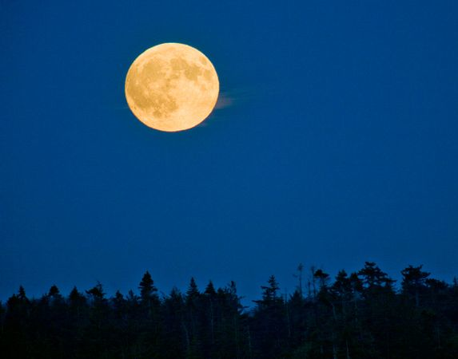
Light from the Moon? It’s NOT a STAR?
We learned in our last chapter that our Sun, a star, is the only object in our Solar System that produces light. So why do we see the moon “shine”? What we are really seeing is the Sun’s light reflecting or bouncing off the Moon’s surface. This is the same reason we see ourselves in a mirror. Our image reflects off the mirror just the same way the light reflects off the moon.

Slide 12
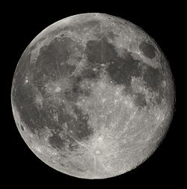
Rotation and Revolution
It takes the Moon 27.3 days to rotate on its axis one time, and 27.3 days to revolve around the Earth one time. It moves about 12⁰ around Earth each day. Because the moon rotates and revolves at the same speed, we only ever see the one side of the moon when standing on Earth. The only people to have seen the other side of the moon with their own eyes are the astronauts that visited the Moon. As with most objects in space, it revolves and rotates in a counter-clockwise direction.
Far side of the Moon
Normal view

Slide 13
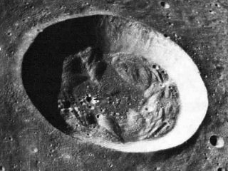
Surface of the Moon
The surface of the moon has many physical features on it such as craters, plains, mountains, and valleys. Scientists believe most of the craters were formed around 3.5 to 4.5 billion years ago by meteors and asteroids hitting the moon's surface.
The largest crater is on the side of the moon we can’t see. It’s called South Pole - Aitken Basin, and is 2,240 km wide.

Slide 14
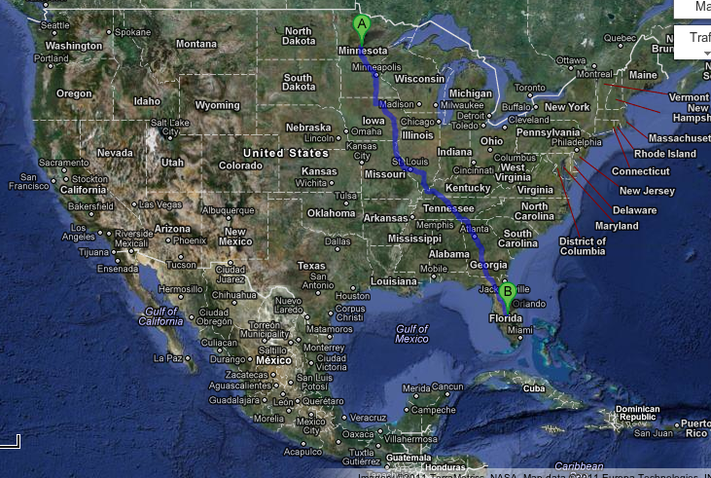
That makes the crater’s diameter ABOUT the size of the distance you’d travel to get from Minnesota to Florida.

Slide 15
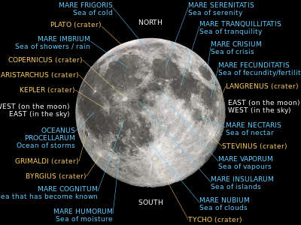
Seas on the moon are actually large plains. Very early astronomers thought they were large seas of water. For some reason, most of the seas are on the side of the moon we can see from Earth. Apollo 11 landed at Sea of Tranquility.

Slide 16
Why So Many Craters?
As we learned in our last chapter, the Earth’s atmosphere burns up 100s to 1,000s of meteors each day because of friction. These meters never reach Earth’s surface to cause damage. But the Moon has no atmosphere, so the meteoroids can’t burn up. They just hit the surface of the Moon and create craters.

Slide 17
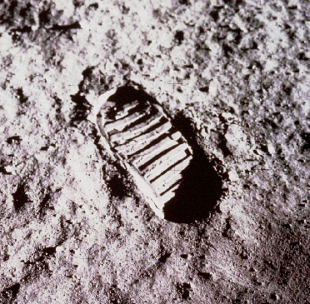
“Weather” or Not
As we mentioned on the last card, the Moon has no atmosphere. Because of this, the moon also has no wind, running water, rain or weather of any kind. That means that there is also no erosion (the wearing away of the Moon’s surface).
This footprint left by an astronaut will remain on the Moon’s surface indefinitely because there is no wind to blow it away and no liquid water to wash it away.

Slide 18
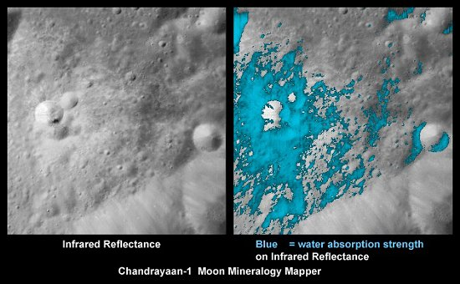
Water, Water Everywhere !!
There is no liquid water on the moon. However, 600 million metric tons of water ice has been found at the bottom of craters at the lunar north and south poles. This important resource could be mined to produce drinking water, oxygen or rocket fuel to support a future moon base. (http://www.space.com/7987-tons-water-ice-moon-north-pole.html)

Slide 19
The End

