Slide 1
Barn Owls
What Amazing Predators
Created by: Mrs. Cosnowski

Slide 2
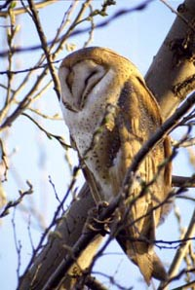
Barn Owls
This is a picture of a barn owl.
You can tell this is a barn owl by the heart shaped face.

Slide 3
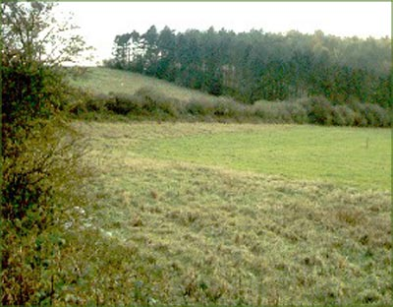
Where Barn Owls Live
They live in open countryside that contains a good mixture of Rough Grasslands,marsh land, young trees, edge of woodland, old barns, tree hollows and nest boxes.

Slide 4
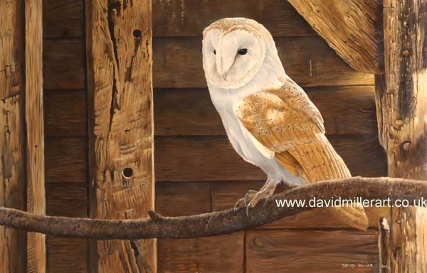
Owl Facts
Barn Owls are nocturnal, meaning they hunt at night.
They are carnivores meaning they eat meat.

Slide 5
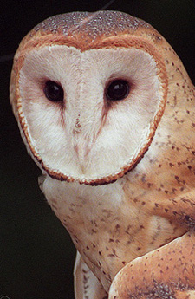
How Barn Owls Hunt
Barn Owls mainly hunt by sound rather than by sight. With its acute hearing the Barn Owl can detect the slightest movement & sound of its prey. The ears are set with one higher than the other under the feathering of the inside edge of the facial disc, located next to the eyes. The facial disc acts as an amazing sound funnel, collecting & filtering sound. This allows the Owl to detect the movement of its prey with complete accuracy.

Slide 6
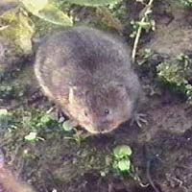
What Barn Owls Eat
The main diet for the Barn Owl is the short-tailed Vole; other rodents include shrews, wood mice, and young rats. They also eat small birds. Owls swallow their pray whole digesting what they are able from their meal.

Slide 7

Barn Owl Eating Prey

Slide 8
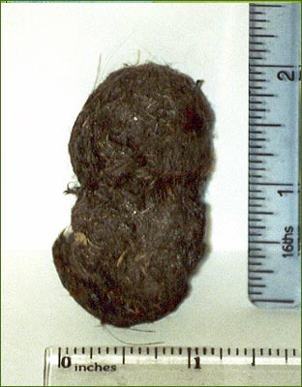
Owl Pellets
An owl pellet is the remains of what the owl can’t digest. He coughs it up and spits it out. It contains the bone, fur and feathers from the animals it has eaten.

Slide 9
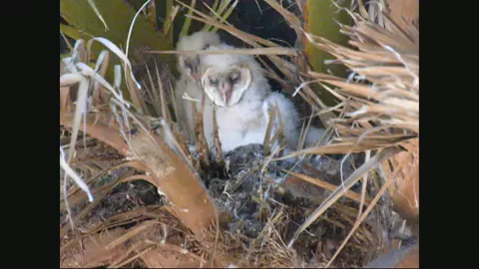
Where Does the Pellet Come From?

Slide 10
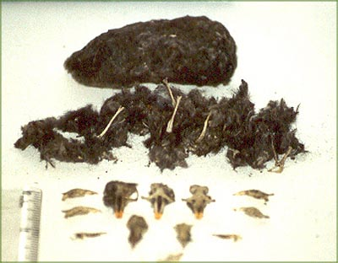
Contents of Pellets
In the center you can see the skulls of the animals this owl ate. They will often eat many animals before it disposes of the indigestible food.

Slide 11
Virtual Owl Pellets
On Monday you’ll be dissecting your own owl pellets to discover what they had for dinner, but today we’re going to demonstrate virtually what you’ll be doing.
http://www.kidwings.com/owlpellets/flash/v4/index.htm

